Slide 1

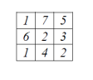
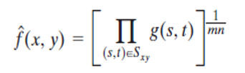
Digital Image Processing
Geometric mean filter
f (x,y) = [1*7*5*6*2*3*1*4*2]^{1/9} = [10080]^{1/9} = 2.78

